Slide 1
Live Animal Imaging and Analysis Core
BMSB Location
Nanette Wheatley, Systems Manager

Slide 2
BMSB LAI Core
Locations & Equipment
PPE
SOPs/Traffic
Scheduling
Timeline
Website

Slide 3
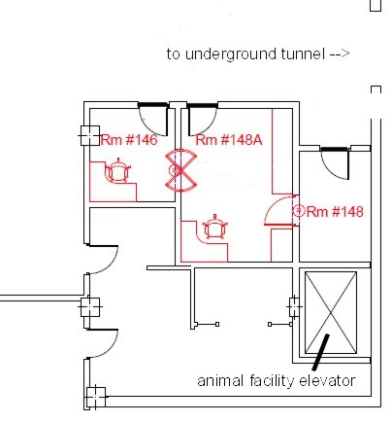
Locations & Equipment
1st floor
OCT
Micron III

Slide 4
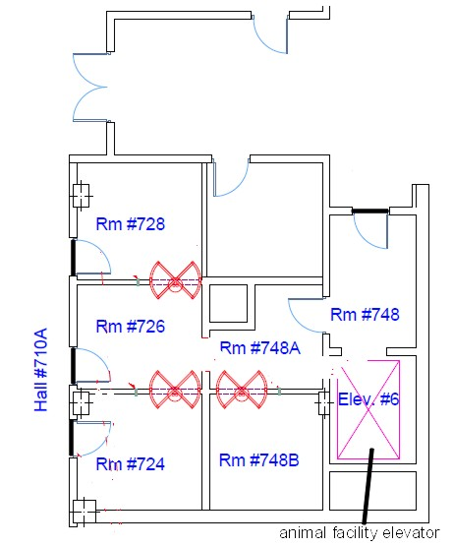
Locations & Equipment
7th floor
2 ERGs

Slide 5
SOPs/Traffic
Access through the ARF elevator only.
Exit ARF elevator into Room 148.
Rooms 148A and 146 will house the Micron III, OCT, and Optomotry equipment.
Room 146 is a dark room.
All doors indicating entrance into these rooms will be locked from the inside and cannot be accessed from the hall leading to the underground tunnel.

Slide 6
SOPs/Traffic
Access through the ARF elevator only.
Exit Elevator 6 into Room 748.
Rooms 748A and 726 will have normal lighting.
Rooms 728 and 724will be dark for ERGs and dark adapting animals.
Room 748B will house OIR equipment.
All doors indicating entrance into these rooms will be locked from the inside and cannot be accessed from the hallways.

Slide 7
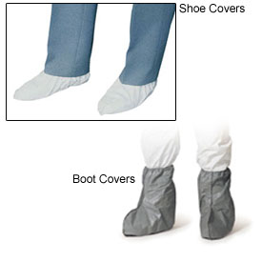
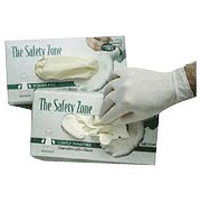
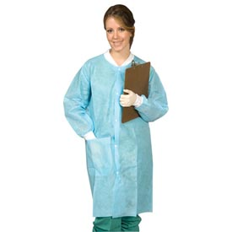

SOPs/PPEs
Full PPE must be worn when transporting animals to and from the Core rooms.
Full PPE must be worn when working in the Core rooms.
No exceptions.
PPEs are provided in the anterooms outside the elevator (148, 748).
Discard your PPEs in the anterooms before returning your animals/cages to the ARF. ARF PPE are in the ARF elevator.

Slide 8
SOPs/PPEs
Animals taken outside the Core rooms on either floor may not return to the Core.
Traffic patterns and door locks are such that once personnel (and animals) exit a Core room into a hallway, they cannot return to the Core.
Traffic patterns exist to prevent contamination in the Core rooms and the ARF.

Slide 9
SOPs/PPEs
Animals MUST be in clean cages before entering the Core
PLEASE KEEP THESE ROOMS CLEAN!!!
Cleaning/decontamination solutions will be provided

Slide 10
Supplies
The Core will provide…
  PPEs
  Cleaning products
You will provide…
  Anesthetics
  Animals
  Electrodes/Gels/Drops
  External Hard Drives

Slide 11
Overnight Dark Adaptation
You must have at 12-hour outside housing exemption approved in your IACUC protocol.
Empty cage in place with special cards for saving your space
White board outside the dark room
Adequate food & water
Animals MUST be in clean cages before overnight stay
PLEASE KEEP THESE ROOMS CLEAN!!!

Slide 12
Training
Current Users must exhibit proficient use of equipment.
New Users:
  Must be approved to work on an IACUC protocol. New users are added to protocols by the PI by amendment.
  Request a training session by emailing the Systems Analysts.
  Systems Analysts will provide documents with information on all Procedures for each piece of equipment. Read and sign those documents.
Equipment Log-Ins

Slide 13
Scheduling
Scheduling is done through Google calendar
Each individual wanting access to the equipment must schedule their time through the calendar
Only the person intending to use the equipment at a given time can schedule the time (you can’t ask someone else to schedule your time for you)
Access to the calendar will be given after SOP training
Most people choose to have a separate account accessible with their ouhsc email address

Slide 14
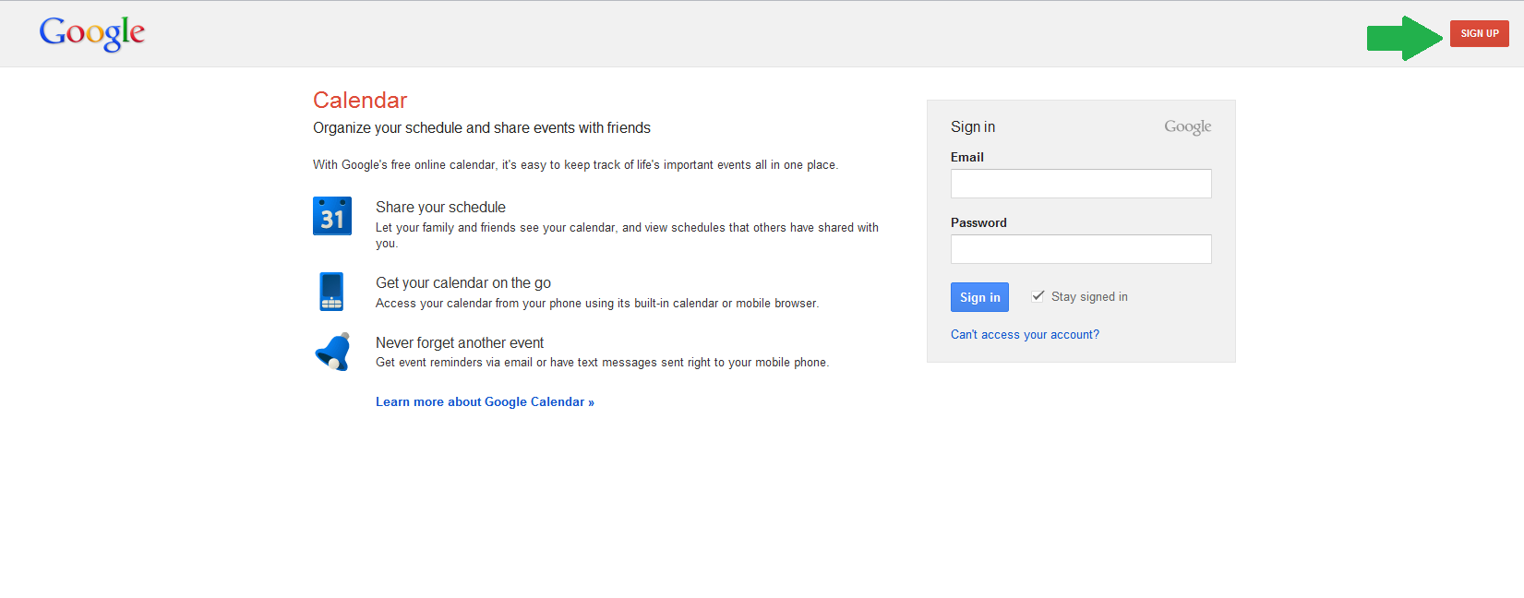
Creating an Account

Slide 15
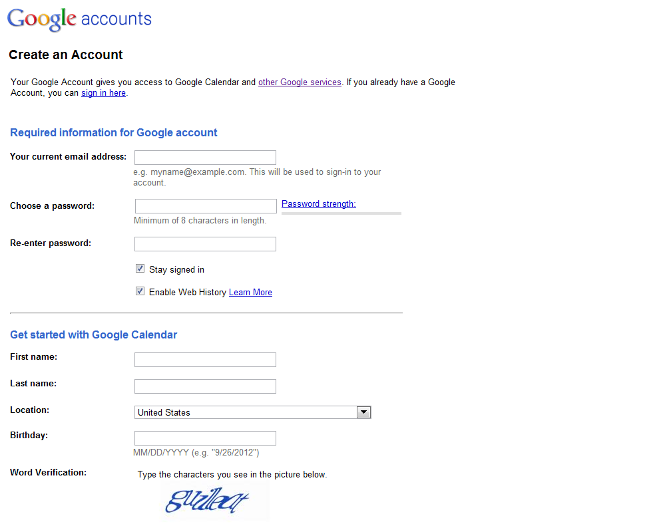

Slide 16
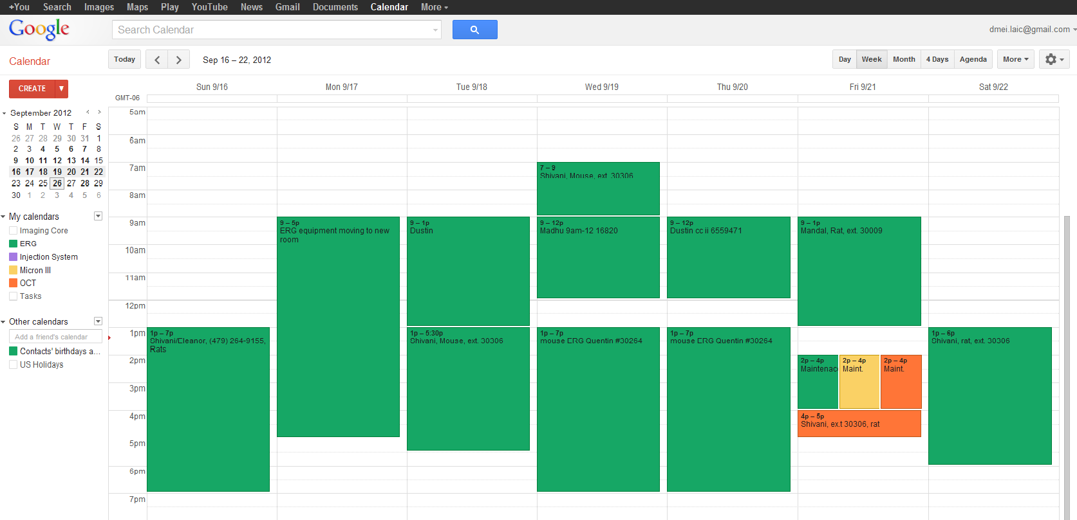
Google Calendar

Slide 17
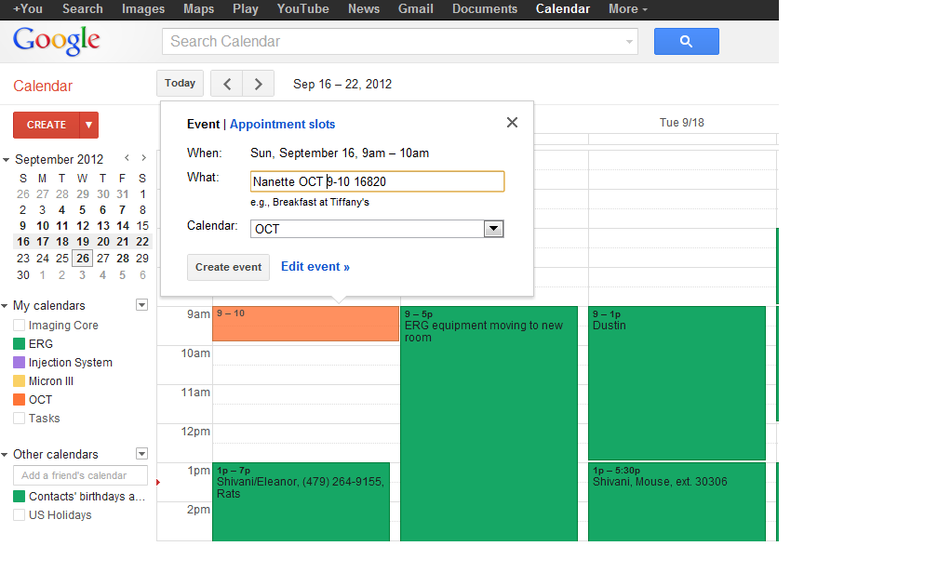
Scheduling with Google Calendar

Slide 18
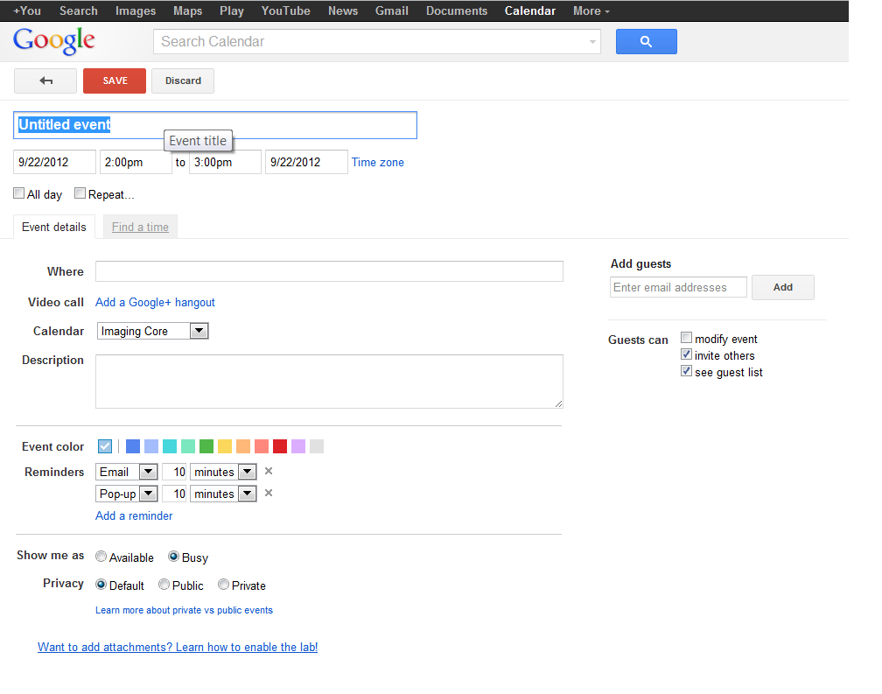

Slide 19
www.ouhsc.edu/mpeir/laicore

