Slide 1
The COVID-19 Pandemic
Dale W. Bratzler, DO, MPH, MACOI, FIDSA
Chief COVID Officer – University of Oklahoma
Professor College of Medicine
Enterprise Chief Quality Officer – OU Health
Professor and Chair, Department of Health Administration and Policy Hudson College of Public Health
Edith Kinney Gaylord Presidential Professor
Email: dale-bratzler@ouhsc.edu
Office Phone: (405) 271-3932
September 2, 2021

Slide 2
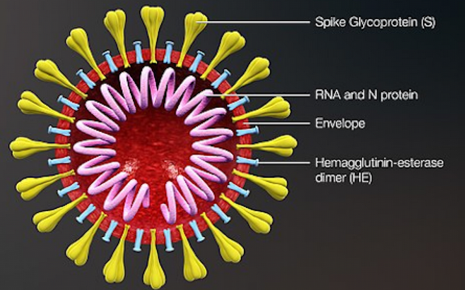
Spike glycoprotein:
Target for vaccines
Subject to mutations

Slide 3
United States:
39,399,703 Cases
642,096 Deaths
https://coronavirus.jhu.edu/map.html
Data as of 09/02/21.

Slide 4
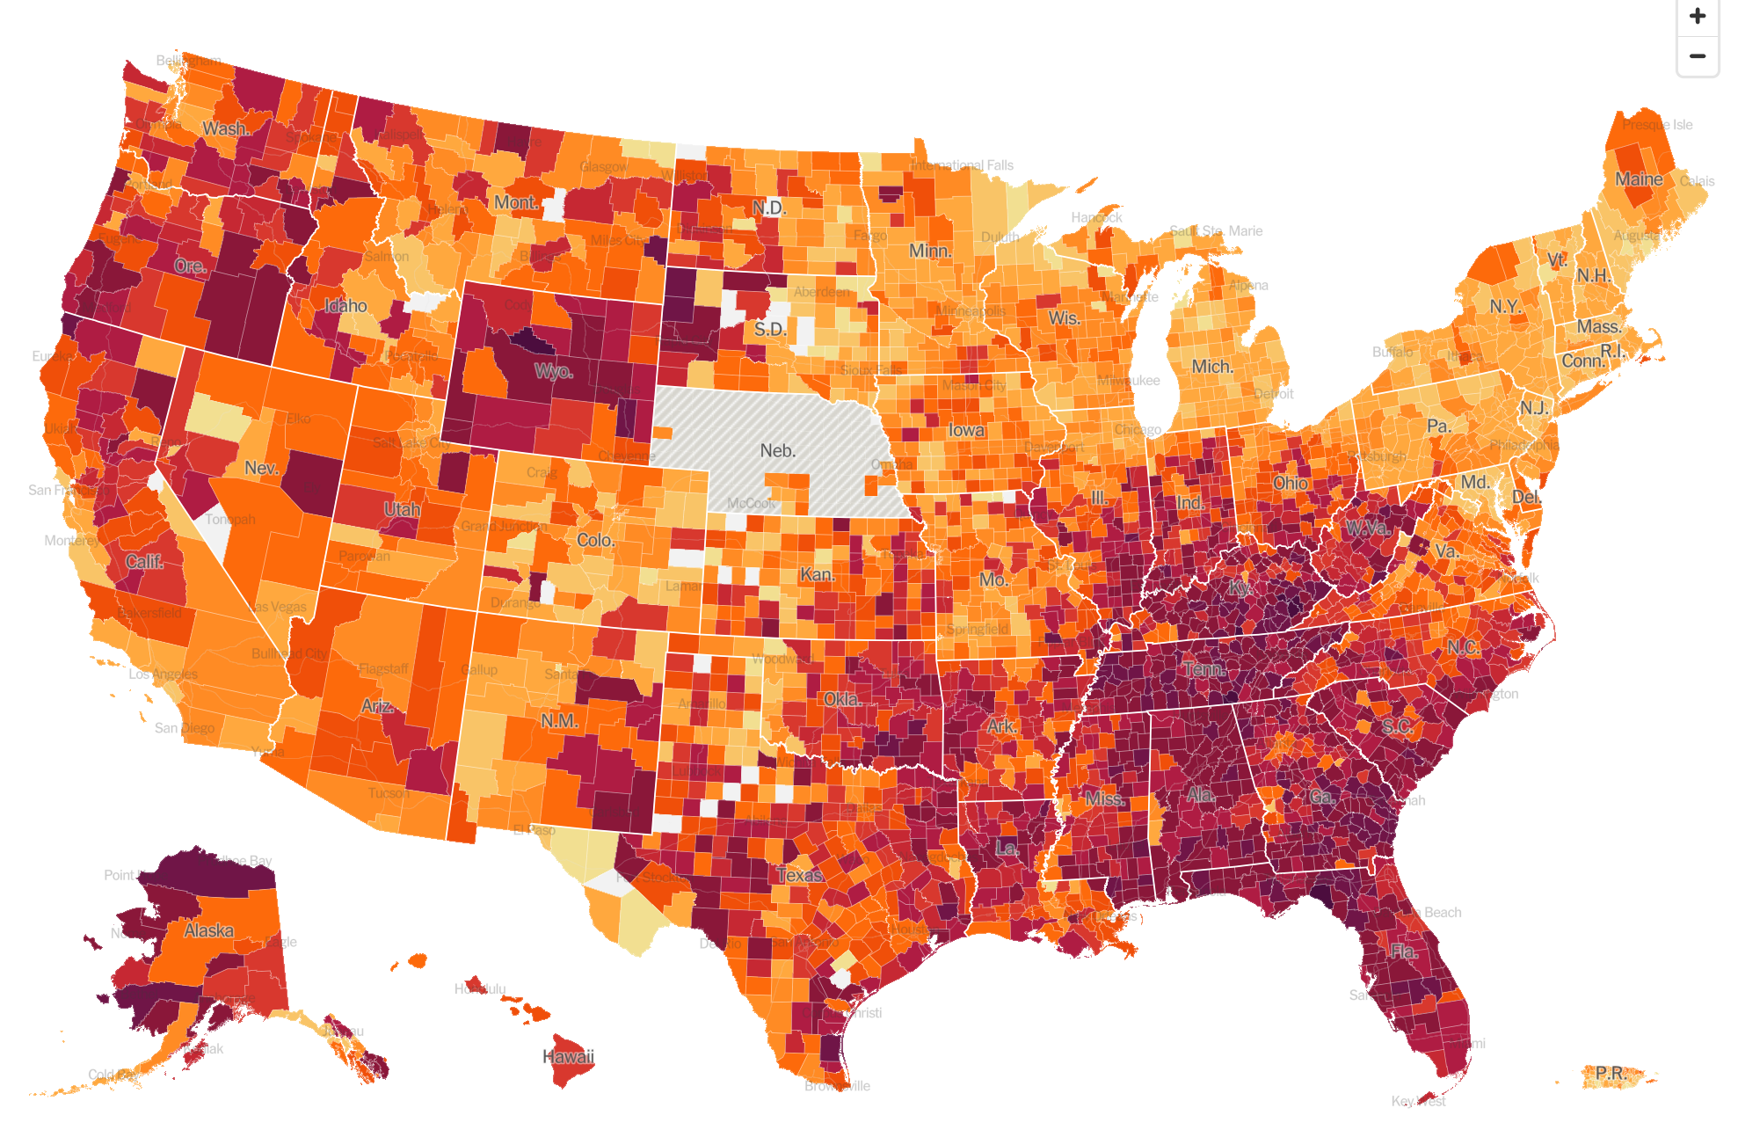

Slide 5
National Ranking – New Cases per 100,000 Population in the Past Week Top Ten
State or Territory | 7-day Case Rate per 100,000 population
Tennessee | 720.1
South Carolina | 692.1
Mississippi | 654.8
Florida | 647.2
Georgia | 623.9
Guam | 591.8
Wyoming | 529.9
Kentucky | 521.3
West Virginia | 495.8
Oklahoma | 494.7
https://covid.cdc.gov/covid-data-tracker/#cases_casesper100klast7days
Data refreshed September 2, 2021

Slide 6
Daily New Cases with 7-day Rolling Average Oklahoma
Through September 2:
554,496 Confirmed Cases
9,199 deaths (1.7%)
January 20
2714 New/Day
September 2
2796 New/Day
November 19
2807 New/Day

Slide 7
Seven-day Rolling Average of New Cases Oklahoma – Last 14 days

Slide 8
Seven-day Rolling Average of New Cases Oklahoma – Since June 7

Slide 9
 | Daily Average Cases | Daily New Cases per 100,000 population in the Last 7 Days
Oklahoma | 2,796 | 71
County:
Adair | 29 | 129
Cherokee | 53 | 109
Choctaw | 16 | 107
Sequoyah | 40 | 96
Nowata | 10 | 95
Okfuskee | 10 | 86
Mayes | 34 | 82
Haskell | 10 | 81
Washington | 41 | 79
Le Flore | 37 | 75
Atoka | 10 | 75
Pushmataha | 8 | 73
McCurtain | 23 | 71
Love | 7 | 68
Cimarron | 1 | 67
McClain | 27 | 66
Latimer | 7 | 65
Woods | 6 | 65
Delaware | 28 | 64
Garvin | 18 | 64
State population incidence through September 1.
County data last updated August 25
Oklahoma County – 51*
Tulsa County – 53*
Cleveland County – 50*
*Daily New Cases per 100,000 population in the past week.

Slide 10
County | New Cases in the Past Week*
OKLAHOMA | 3504
TULSA | 2906
CLEVELAND | 1338
WAGONER | 635
COMANCHE | 622
ROGERS | 544
CANADIAN | 540
PAYNE | 511
CHEROKEE | 457
CREEK | 408
POTTAWATOMIE | 384
MUSKOGEE | 383
CARTER | 326
WASHINGTON | 318
PITTSBURG | 287
SEQUOYAH | 282
MAYES | 268
OKMULGEE | 260
MCCLAIN | 258
PONTOTOC | 257
GRADY | 254
LE FLORE | 235
BRYAN | 221
*Data reported by OSDH on September 1, 2021.

Slide 11
Hospitalizations – Confirmed Cases
441/1,566 (28%) in ICU on September 1, 2021*
*3-day Average

Slide 12
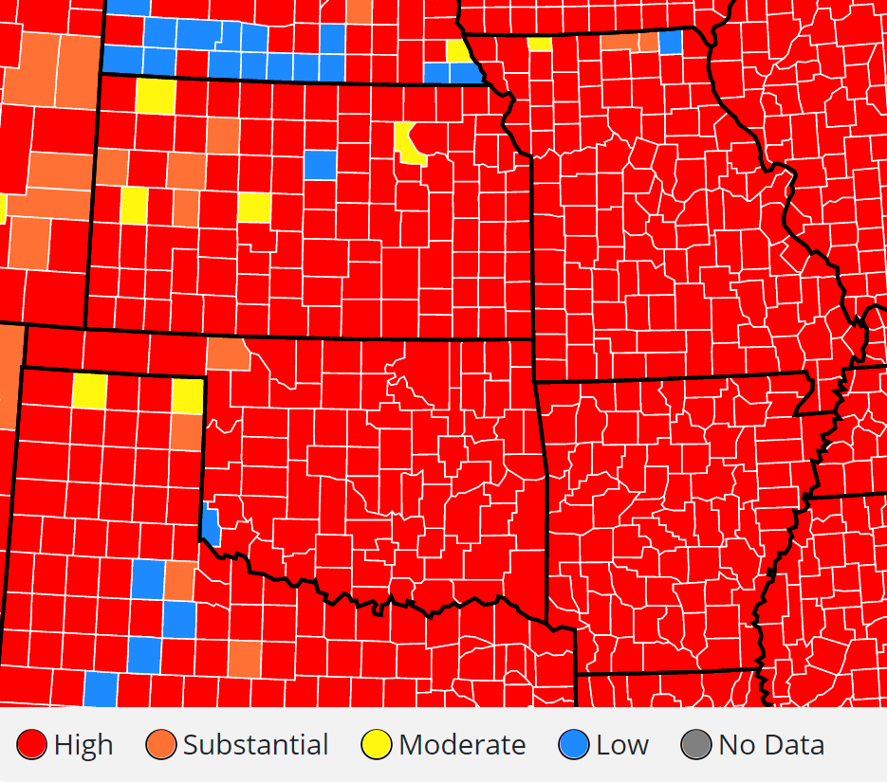
Community Transmission Rate
Time Period: August 25, 2021 – August 31, 2021.
https://covid.cdc.gov/covid-data-tracker/#county-view
RED - > 100 new cases per 100,000 per week; or > 10% rate of positive COVID tests in the past week.
Data refreshed: September 2

Slide 13
Recent COVID News

Slide 14
Large national study from England of 43,338 COVID-infected patients.
Patients infected with the delta variant (as compared to those infected with the original alpha variant) were 2.3 times more likely to be admitted to the hospital within 14 days of a positive test.
Most infected patients (74%) were unvaccinated.
https://www.thelancet.com/journals/laninf/article/PIIS1473-3099(21)00475-8/fulltext

Slide 15
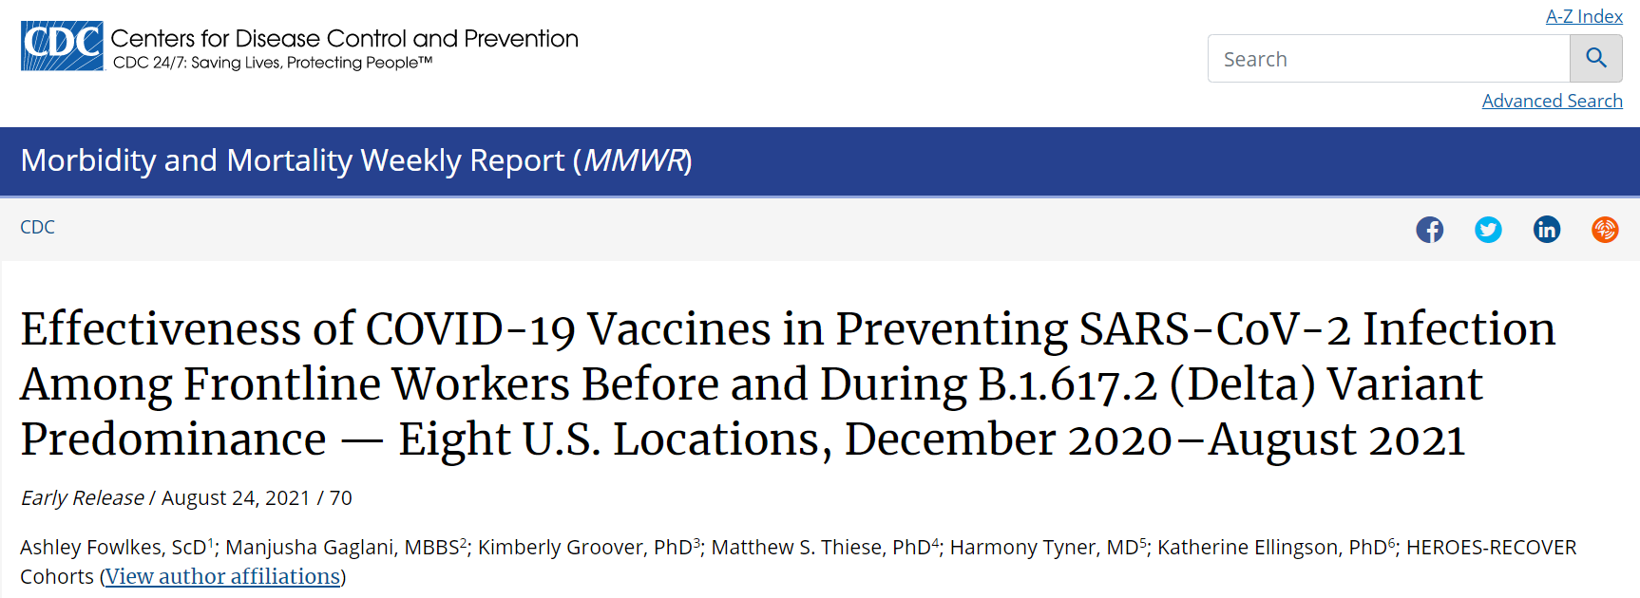
Ongoing study of 4,136 unvaccinated healthcare workers and 2,976 fully vaccinated healthcare workers
Symptomatic or asymptomatic COVID-19 infection confirmed with RT-PCR testing.
Pre-Delta variant vaccine effectiveness – 91%
Delta variant vaccine effectiveness – 66%
Vaccine prevented most infections but over time was less effective – due to Delta variant or did waning immunity contribute?

Slide 16
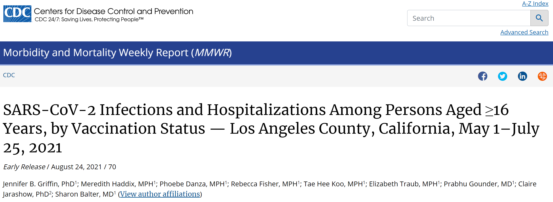
43,127 cases of COVID-19 in people 16 years of age or older
10,895 (25.3%) cases were in fully vaccinated individuals
1,431 (3.3%) in partially vaccinated persons
30,801 (71.4%) were in unvaccinated persons
Only 3.2% of fully vaccinated persons were hospitalized (0.5% were admitted to the ICU and 0.2% required mechanical ventilation).

Slide 17
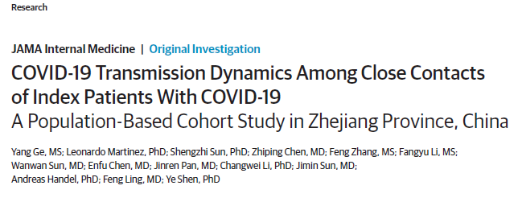
“Findings: In this cohort study of 730 index patients with a COVID-19 diagnosis and 8852 close contacts, transmission potential was greatest in the first 2 days before and 3 days after onset of symptoms in the index patient. When contacts received a diagnosis of COVID-19 infection, they were more likely to present asymptomatically if they had been exposed to an asymptomatic patient.”

Slide 18
Large study reviewing 87 studies with 1,249,163 people who were household contacts of a person with COVID-19.
18.9% of household contacts became infected
Studies from January and February 2020 – 13.4% of household contacts became infected.
Studies from July 2020 through March 21 – 31.1% of household contacts became infected.
JAMA Network Open. 2021;4(8):e2122240. doi:10.1001/jamanetworkopen.2021.22240

Slide 19
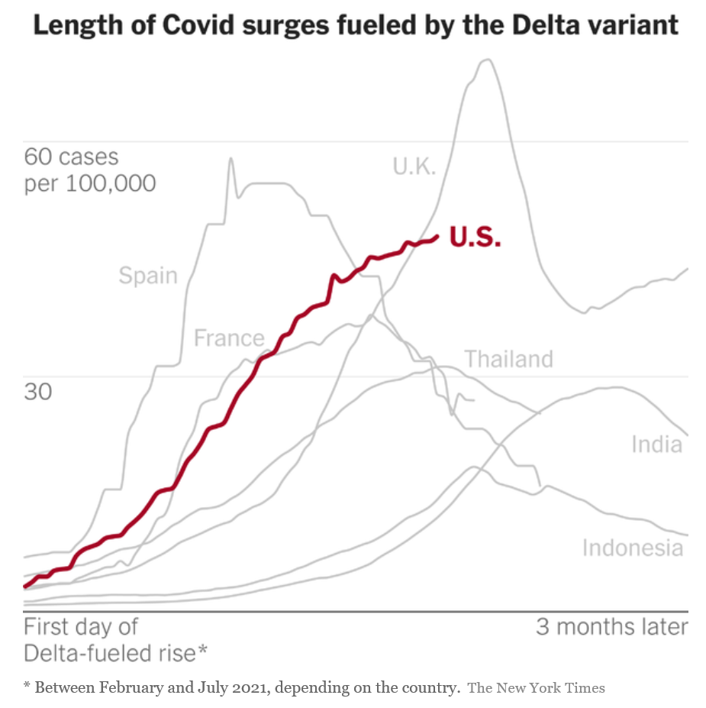
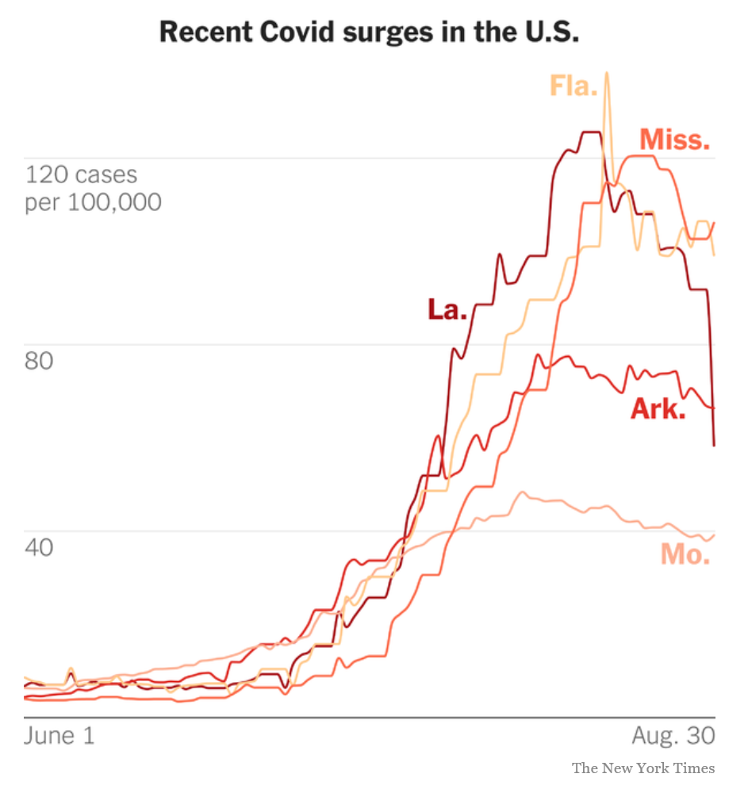
NY Times. September 1, 2021.

Slide 20
How do the vaccines work?
The end result for all three approved vaccines (Pfizer, Moderna, and Janssen) is the same:
Ultimately all of the vaccines get mRNA into the cytoplasm of the cell that will encode the production of the spike protein of the SARS-CoV-2 virus
The spike protein is expressed on the surface of those cells and also released into the circulation
Antigen presenting cells of the immune system recognize the spike protein as foreign and stimulate –
B-cells to produce antibodies
T-cells to activate killer T-cells (and T-memory cells)

Slide 21
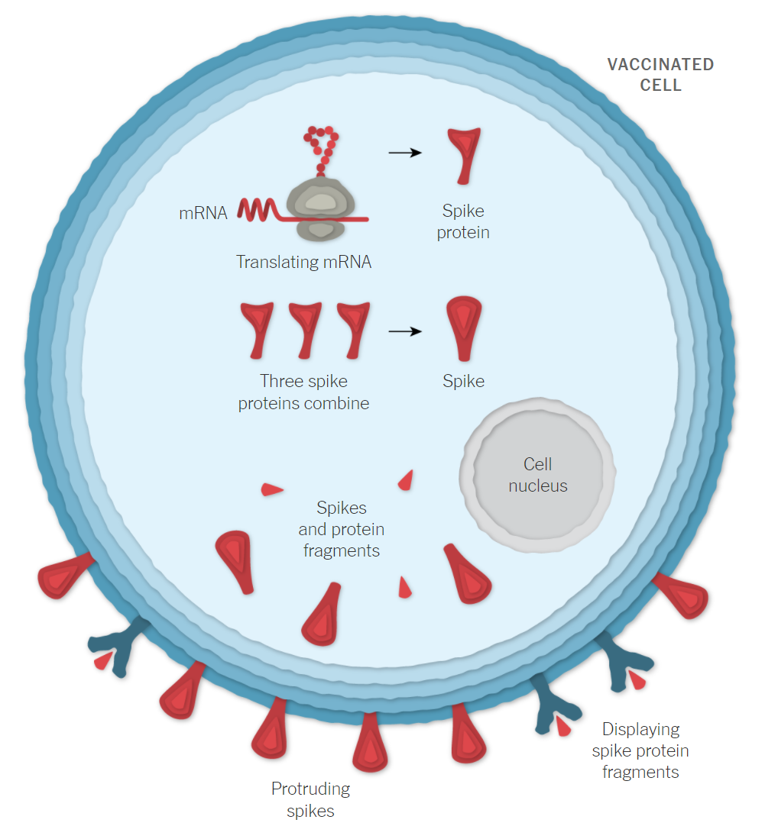
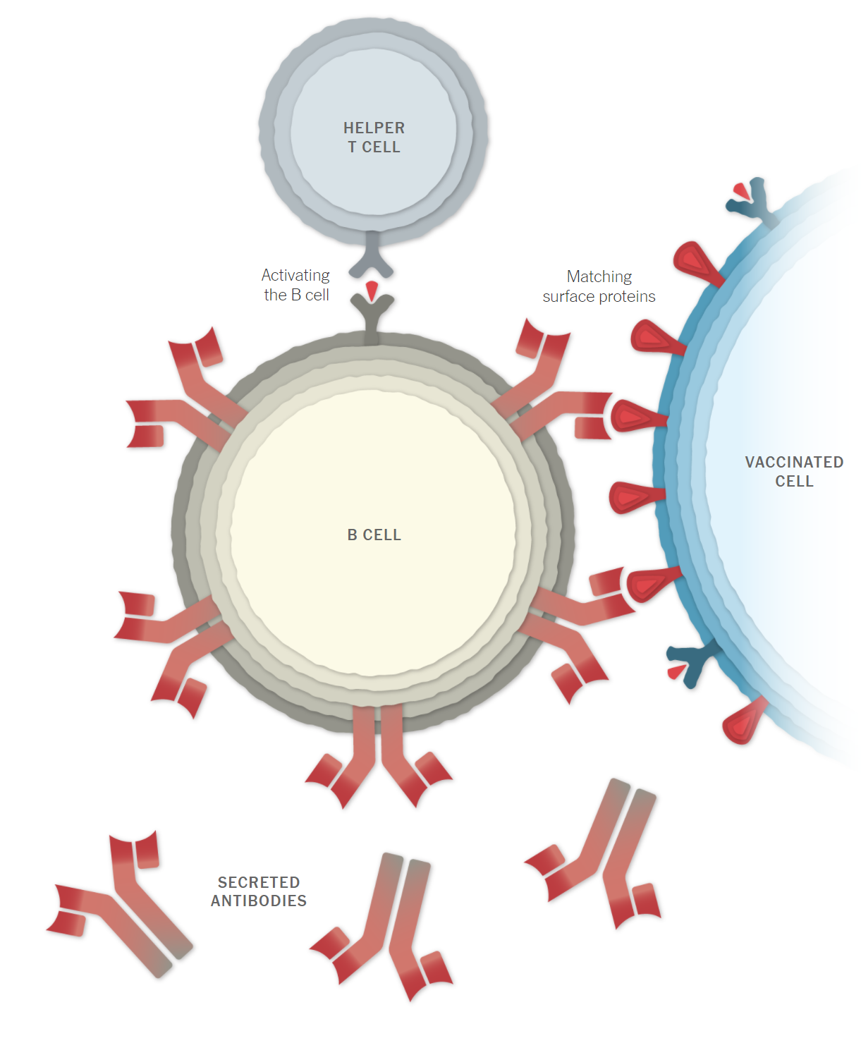
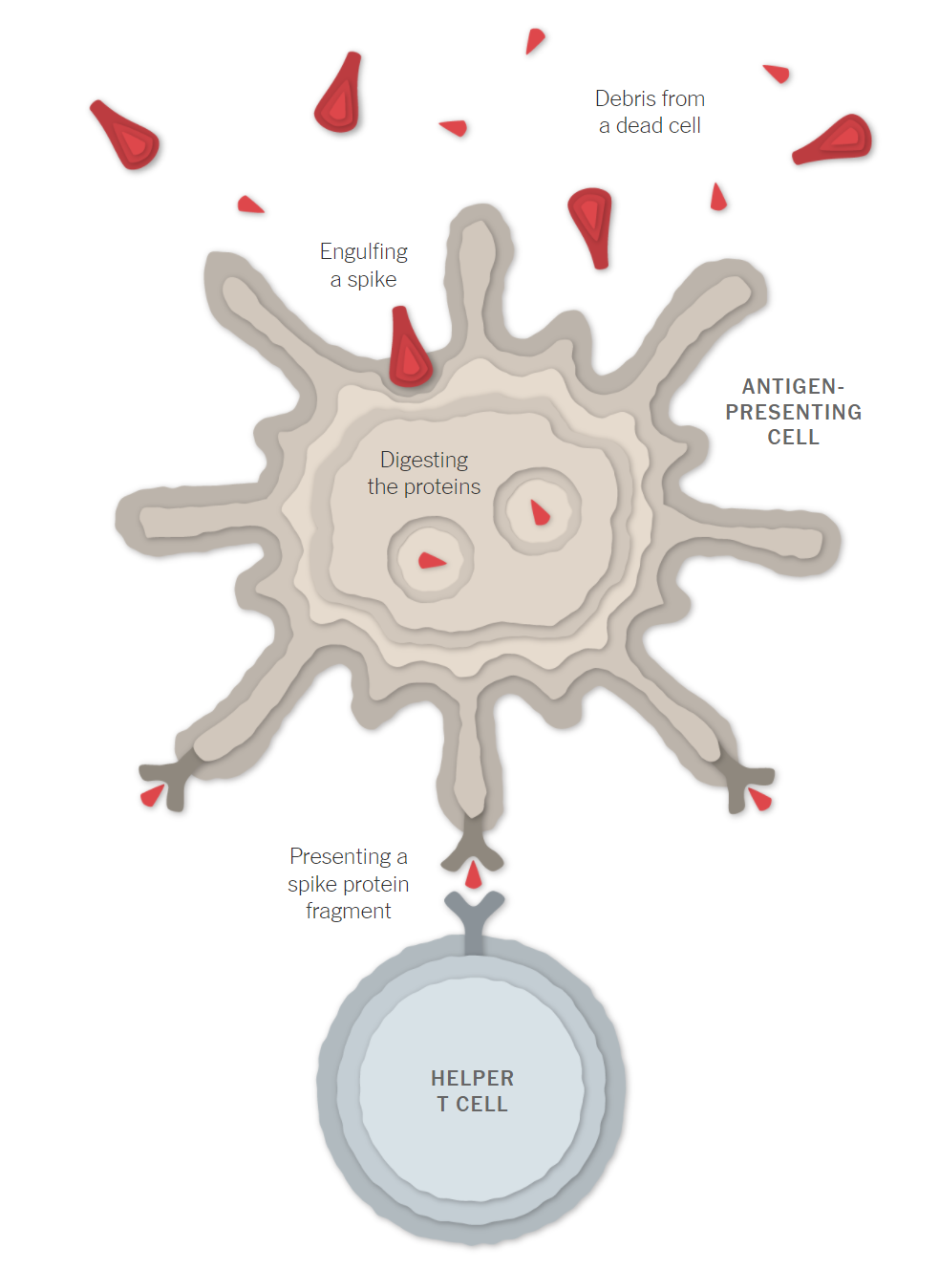
The spike protein is recognized as “foreign” by antigen presenting cells of the immune system
mRNA is translated by the ribosomes to produce the spike protein that is expressed on the surface of the cell and released into the circulation
End result – production of anti-spike antibodies and activated killer T-cells
https://www.nytimes.com/interactive/2021/health/how-covid-19-vaccines-work.html

Slide 22
How do the mRNA and Janssen vaccines differ to stimulate the production of spike protein?

Slide 23
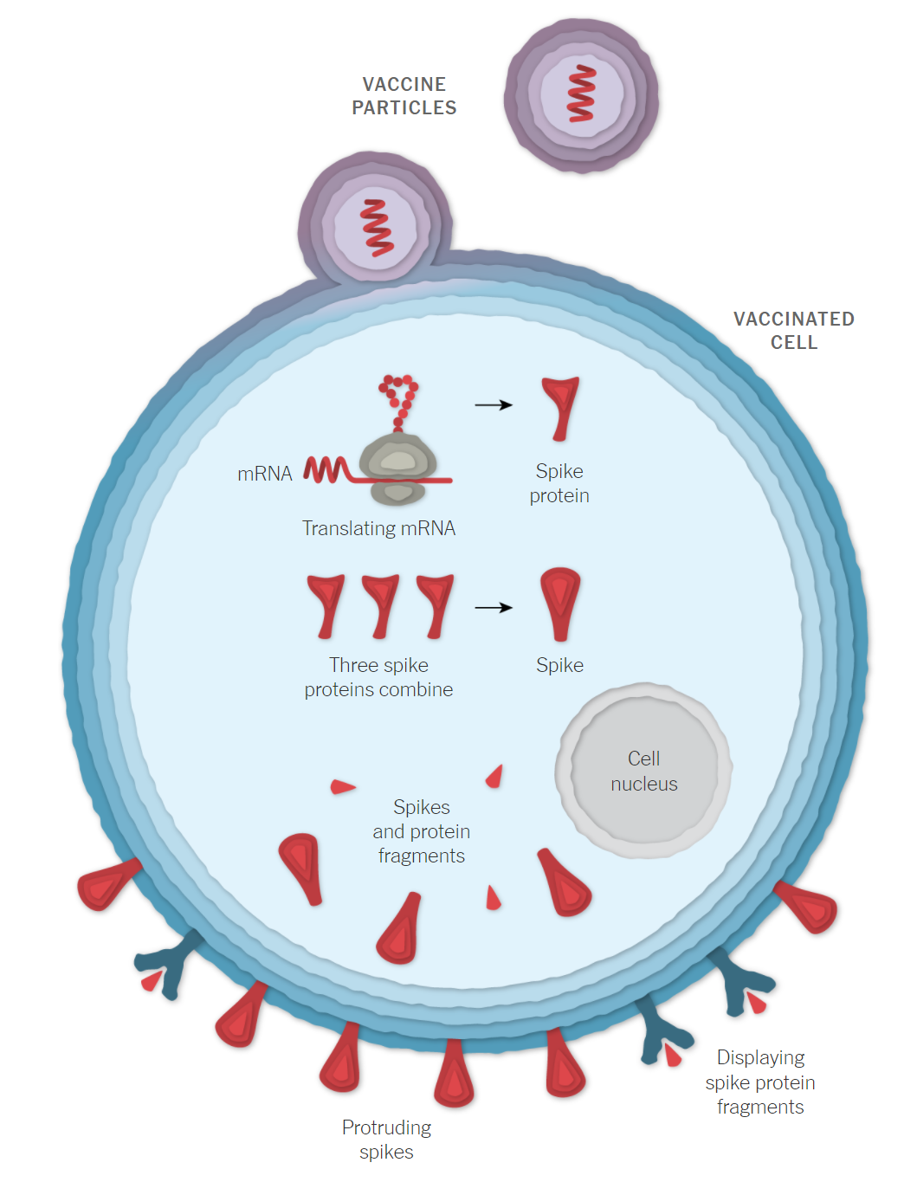
mRNA Vaccines (Pfizer and Moderna)
The vaccine that is injected contains mRNA that will encode for the spike protein. That mRNA is surrounded with a lipid nanoparticle that prevents immediate breakdown of the mRNA on injection.
The mRNA from the vaccine is taken up by the cells to enter the ribosome complex to produce spike protein.
https://www.nytimes.com/interactive/2021/health/how-covid-19-vaccines-work.html

Slide 24
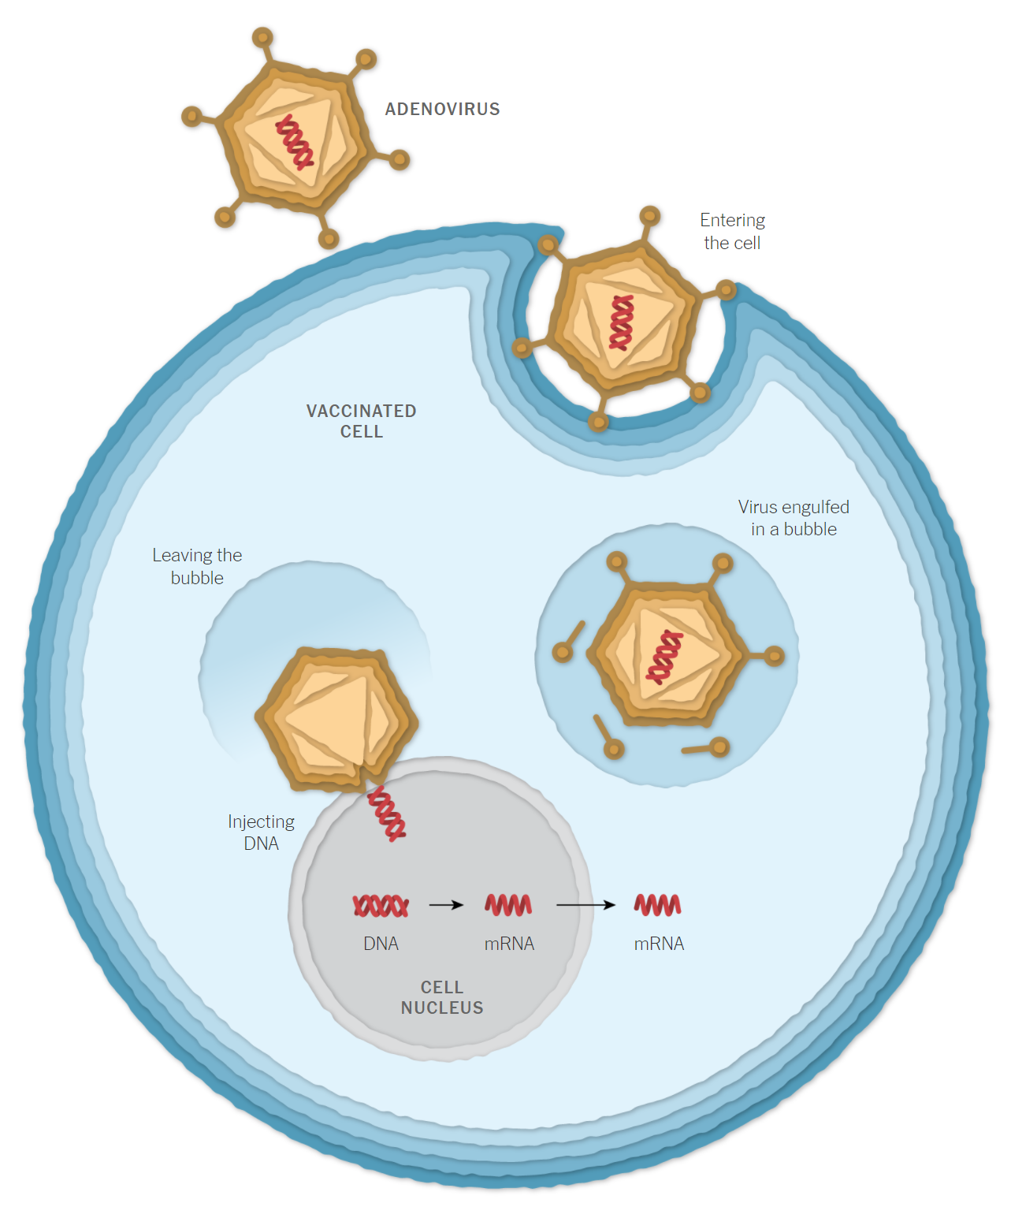
Janssen (J&J) Vaccine
Uses a small piece of DNA from the COVID virus that encodes for production of the mRNA. The DNA is inserted into an adenovirus that has been modified so it cannot replicate.
The adenovirus enters the cell and injects the DNA into the cell nucleus where it is transcribed to mRNA.
The mRNA enters the cytoplasm of the cell to be translated by ribosomes to produce spike protein.
https://www.nytimes.com/interactive/2021/health/how-covid-19-vaccines-work.html

Slide 25
What about booster doses of vaccine?
Patients who are immunosuppressed should be vaccinated with a booster dose now.
For everyone else – it is not yet clear
President suggested that booster doses would start on September 20; however
CDC in particular is not yet convinced that everyone needs a booster – suggested a “risk-based” approach to deciding

Slide 26
https://www.occhd.org/covid-19vaccine

Slide 27
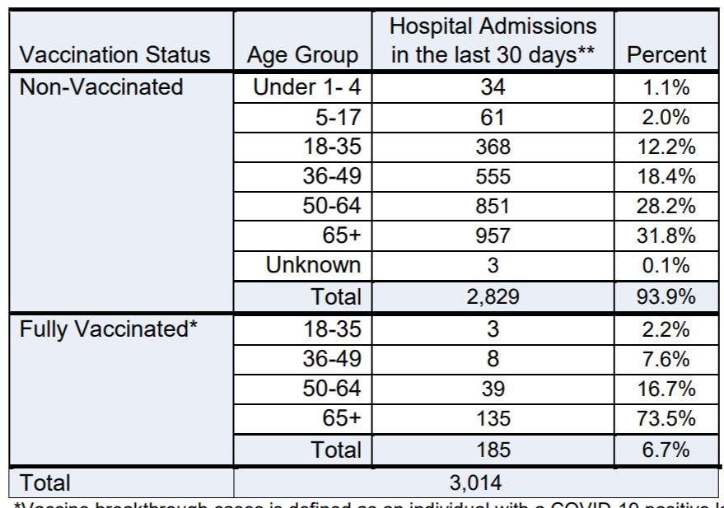

Slide 28
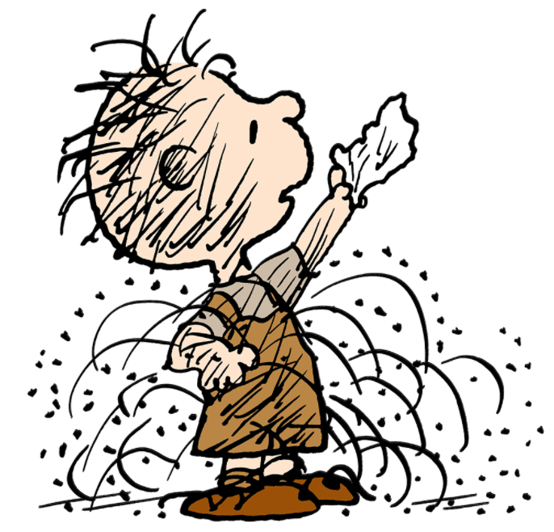
Delta variant
RSV
Influenza

Slide 29
dale-bratzler@ouhsc.edu

