Slide 1
Staff Senate Meeting December 3, 2020

Slide 3
Mind
your
Mute!

Slide 4
OUHSC Staff Senate Business
Call to Order time
November minutes will be approved via email and posted to the Staff Senate Webpage
www.ouhsc.edu/staff senate

Slide 5
Executive committee Treasurer’s Report
 | OUHSC Staff Senate
 | Treasurer's Report
 | Year-to-date Summary
 | September 2020 |  | Year to Date Totals
Beginning Cash Balance | $ 8,942.56 |  | $ 9,092.56
Project/Item | Revenues | Expenses | Revenues | Expenses | Net
Inventory Sales | - | - | - | - | -
Payday on Payday | - | - | - | - | -
Fall Craft Fair | - | - | - | - | -
Fall Fundraiser | - | - | - | - | -
New Employee Orientation Gift | - | - | - | - | -
Christmas Tree Lighting & Reception | - | - | - | - | -
Christmas Fundraiser | - | - | - | - | -
Bedlam Fundraiser |  |  | - | - | -
Cupid Express | - | - | - | - | -
ERC Luncheon | - | - | - | - | -
Staff Week Activities | - | - | - | - | -
Staff Week T-Shirt Sales | - | - | - | - | -
Spring Craft Fair | - | - | - | - | -
Sales Tax | - | - | - | - | -
Sooner Safety Week | - | - | - | - | -
Miscellaneous | 10.00 | - | 10.00 | 150.00 | (140.00)
Summer Fundraiser | - | - | - | - | -
Wacky Games | - | - | - | - | -
Ending Cash Balance | $ 8,952.56 |  | $ 8,952.56
September report approved
October report is still pending

Slide 6
SPOTLIGHT

Slide 7
Committee on committees
At this time, all committees have full rosters.
Senator report
1 current Senator vacancy- College of Medicine
Carol Clure 271-2054 Carol-Clure@ouhsc.edu
Heidi Petitt –Heidi-Petitt@ouhsc.edu

Slide 8
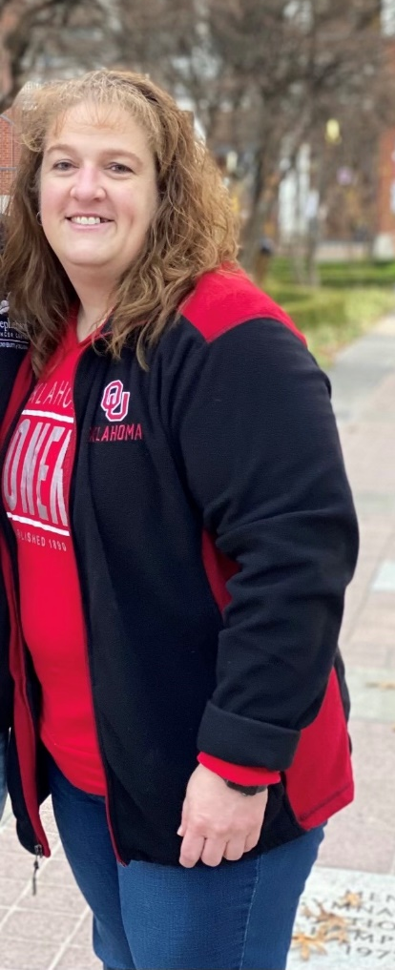
Executive committee
Heidi Petitt elected as Staff Senate Chair Elect 20/21 and Chair 21/22.
Heidi has a long history with Staff Senate and served in many committee roles; she also has a vested interested in our campus community.
Welcome Heidi!

Slide 9
Communication committee
Communication Committee met via zoom on November 19th.
They are currently working on options for a newsletter format as well as promotional materials.
The HSC Communication Committee will continue to be the point for updates to social media, the HSC Staff Senate website, and email. The team works with other SS committees to highlight the efforts, events, outreach, and updates related to HSC Staff Senate. For the latest Staff Senate Updates, follow them at:
Facebook.com/OUHSCStaffSenate
Meetings will be held on the 3rd Thursday of each month.

Slide 10
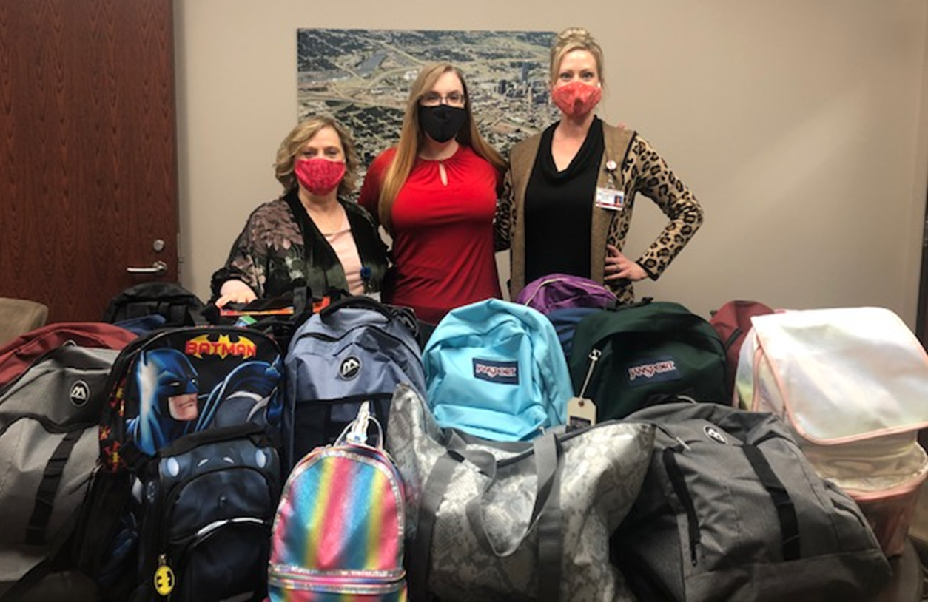
Community outreach committee
In November we supported the OU Child Study Center with collections of donated items to fill backpacks for the Foster Children they work with.
Collections included puzzles, snacks, socks, blankets, juice boxes, coloring books and crayons, etc.
The committee exceed its goal of 15- and provided 19 full bags!

Slide 11
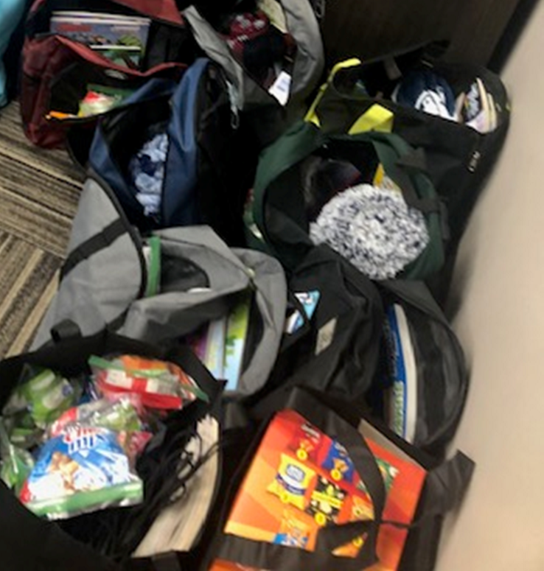
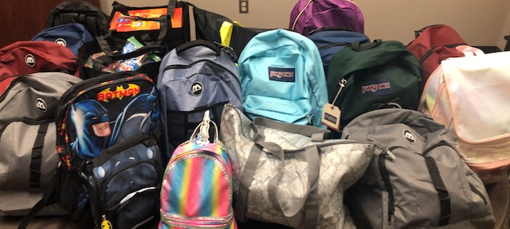
Because of the generous donations, they were also able to provide an additional 10 large/med drawstring bags, a large box filled with individual chips/crackers, extra coloring books, and candies.
Thank you for supporting our OU Community!

Slide 12
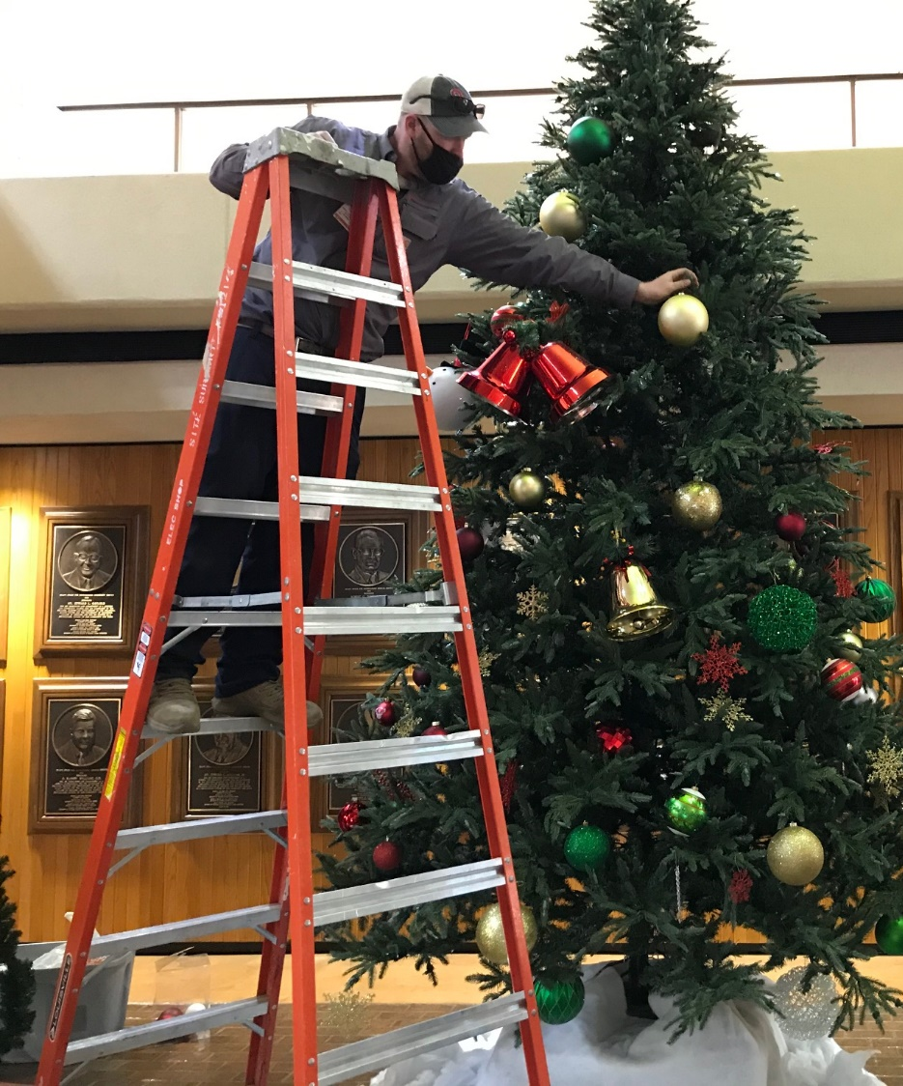
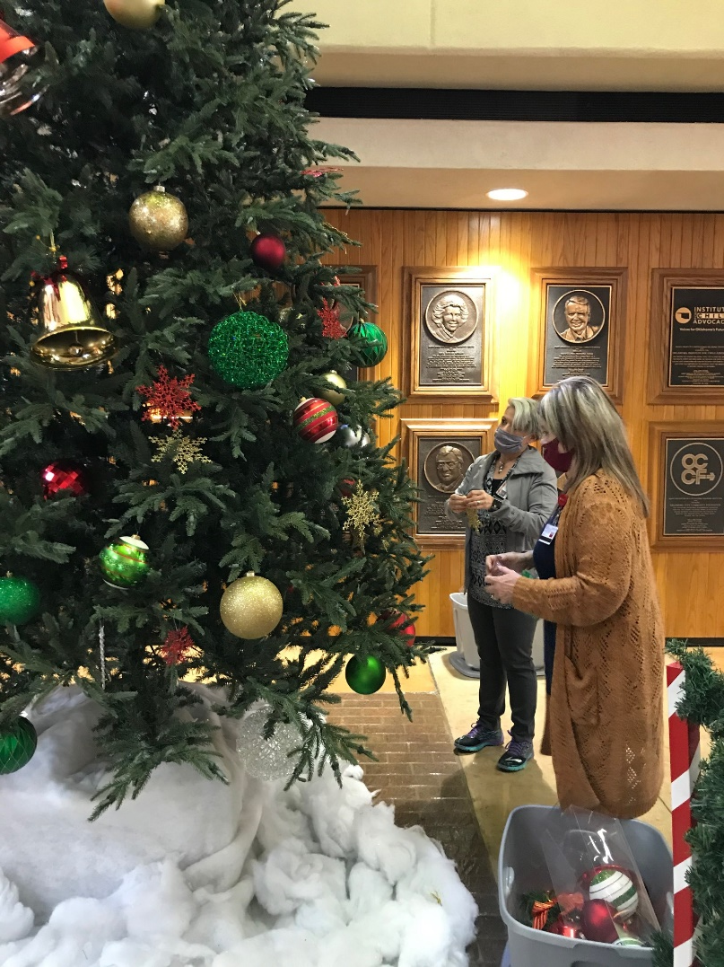
Community Outreach Volunteers and Facilities Management teamed up to decorate this year.

Slide 13
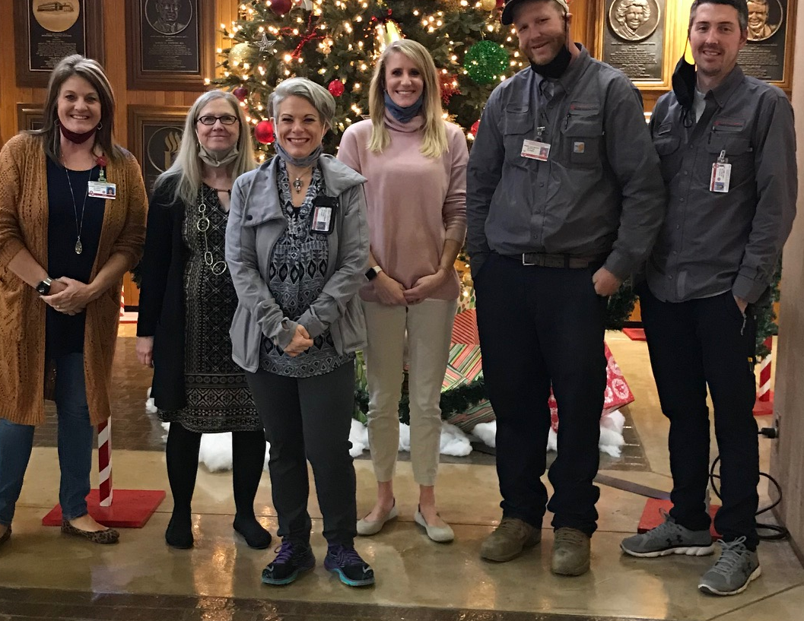
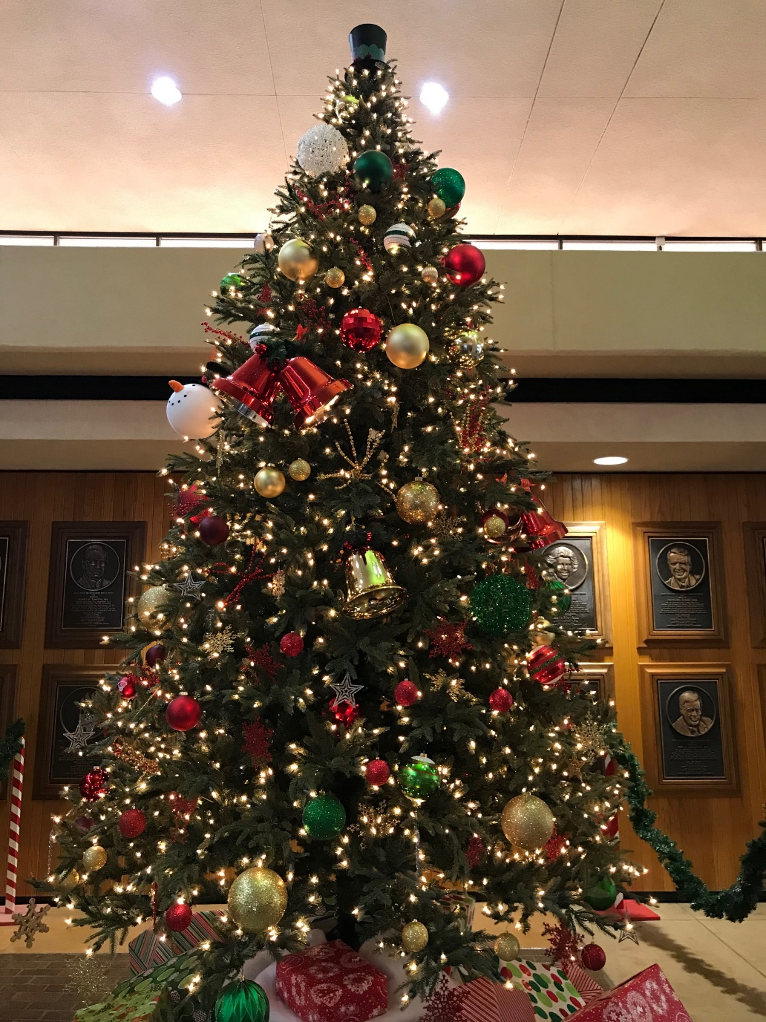
THANK YOU!

Slide 14
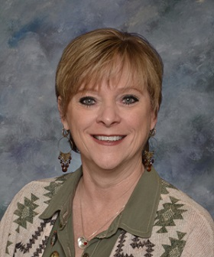
Employee of the Month
Congratulations to our DECEMBER 2020 EOM…. BRENDA FOX
Administrative Coordinator
Department of Communications Sciences and Disorders
College of Allied health Business Office
Staff Events Committee Member
Senator for Allied Health

Slide 15
Employee of the month committee
Eligibility- FT, Non faculty appt. Worked at least 5 consecutive calendar years.
3 letters of support from OUHSC personnel (one from direct supervisor)
Nominee must not have received the Employee of the Month award in the past five years.
Complete eligibility and details can be found on our Staff Senate website.

Slide 16
Fundraising COMMITTEE
Holiday Fundraisers Launched in October-
See’s Candies sales extended until Dec 4th
Bedlam T-shirt sales ended- 335 sold.
Crockstar Dinner sales ended with $168.75 raised.
The funds raised from these sales will support
Staff Senate initiatives on our campus.
Committee meets the 4th Wednesday of the month at 10:30am via ZOOM. Also does business via email.

Slide 18
See’s Candies sales extended until December 4th
Link can be found on Staff Senate Website.

Slide 19
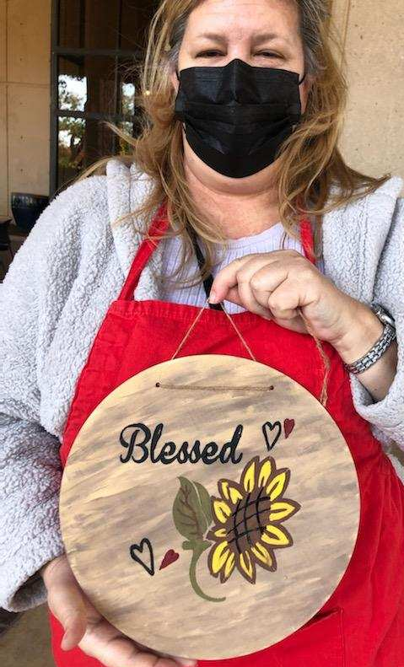
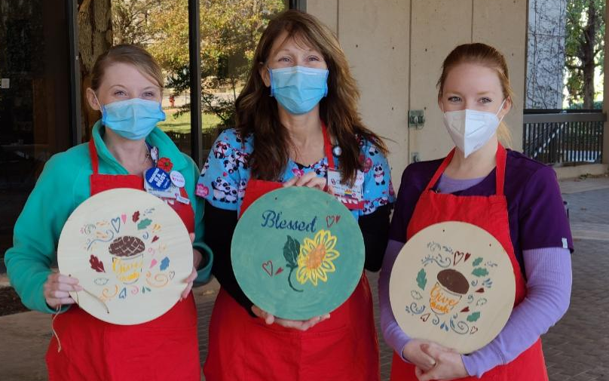
Staff EVENTS Committee
Fall Craft Decorating

Slide 20
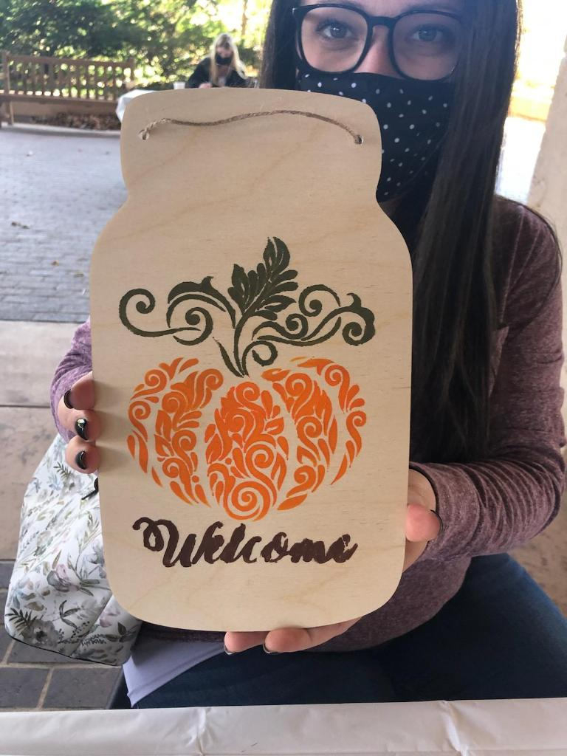
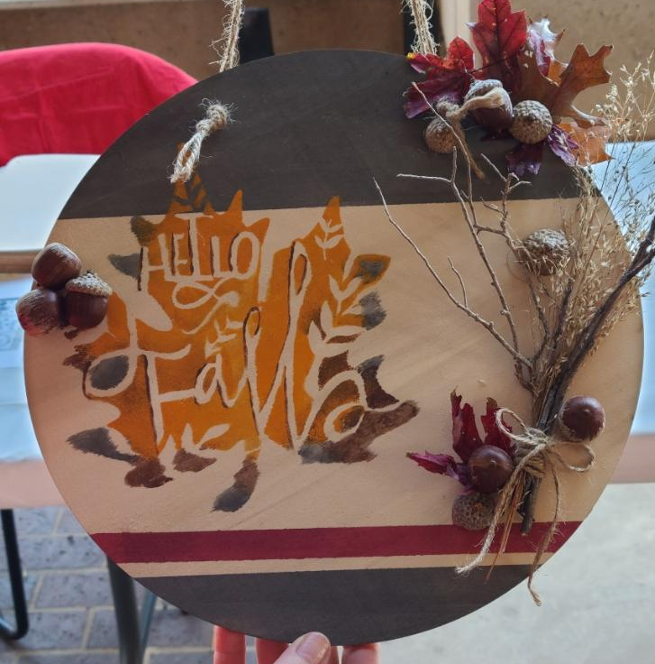

Slide 21
New business and announcements
THE FOLLOWING SLIDES ARE THE UPCOMING EVENTS FOR OUHSC
IF YOUR DEPARTMENT WOULD LIKE AN EVENT FEATURED HERE – PLEASE EMAIL Nancy-Geiger@ouhsc.edu

Slide 22
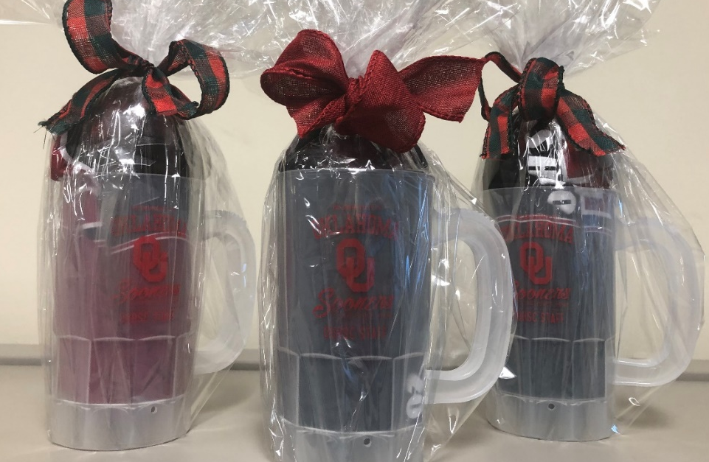
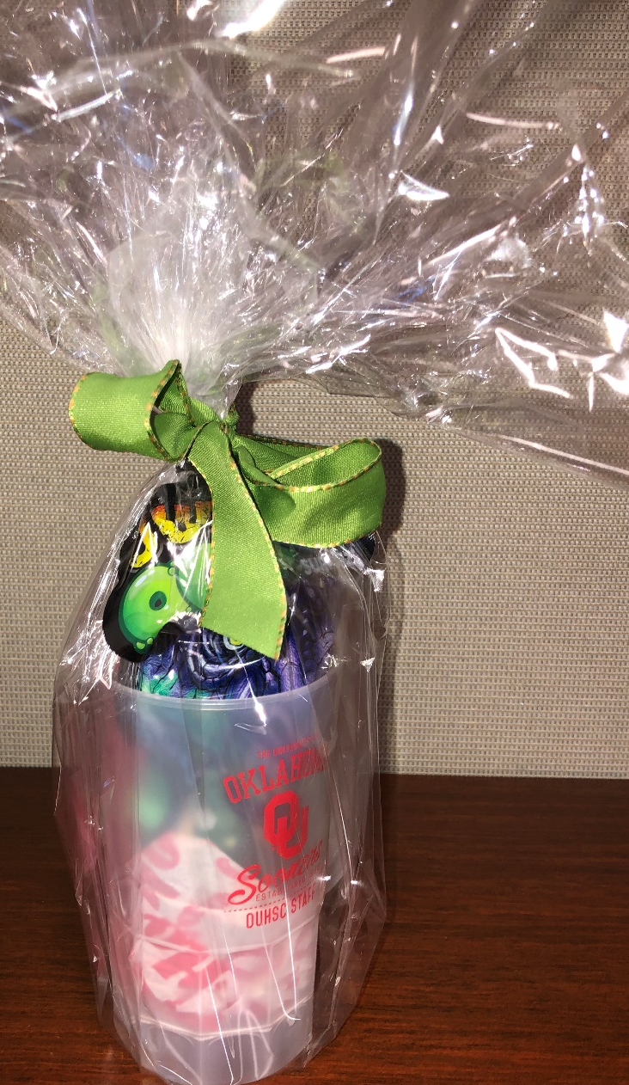
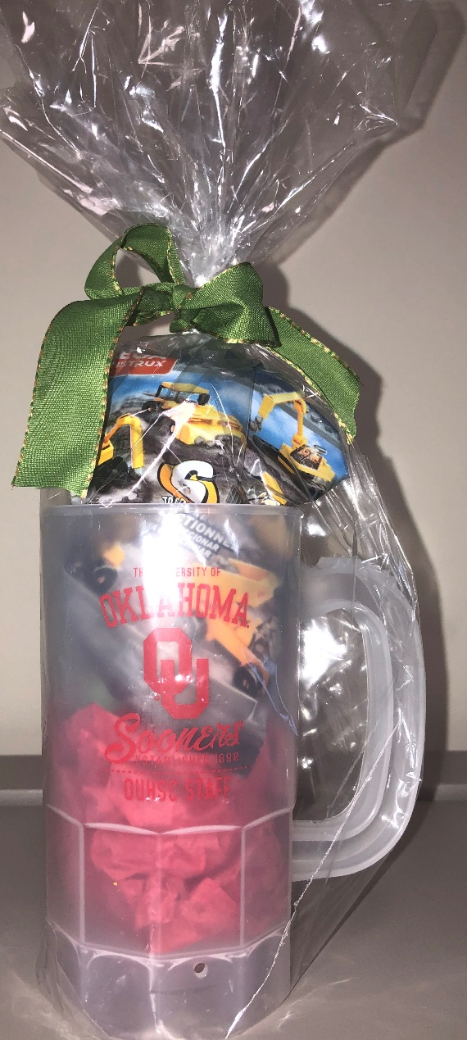
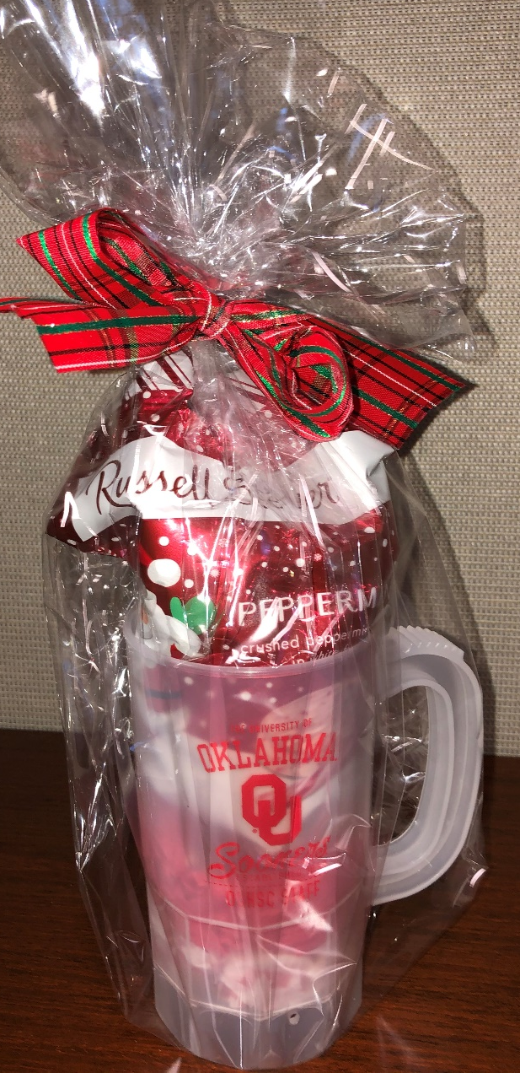
Vintage Stock Plastic mugs
With Staff Senate T-shirts
$10 each
Vintage Stock Plastic mugs
Stocking Stuffer (toys/candy)
$5 each
Sale Dates
Wed, Dec 2- Dec11th
12-2pm or by appointment
Staff-senate@ouhsc.edu
CASH AND CARRY/ Supplies Limited
Staff Senate Office Research Park
Building 865, Suite 529

Slide 23
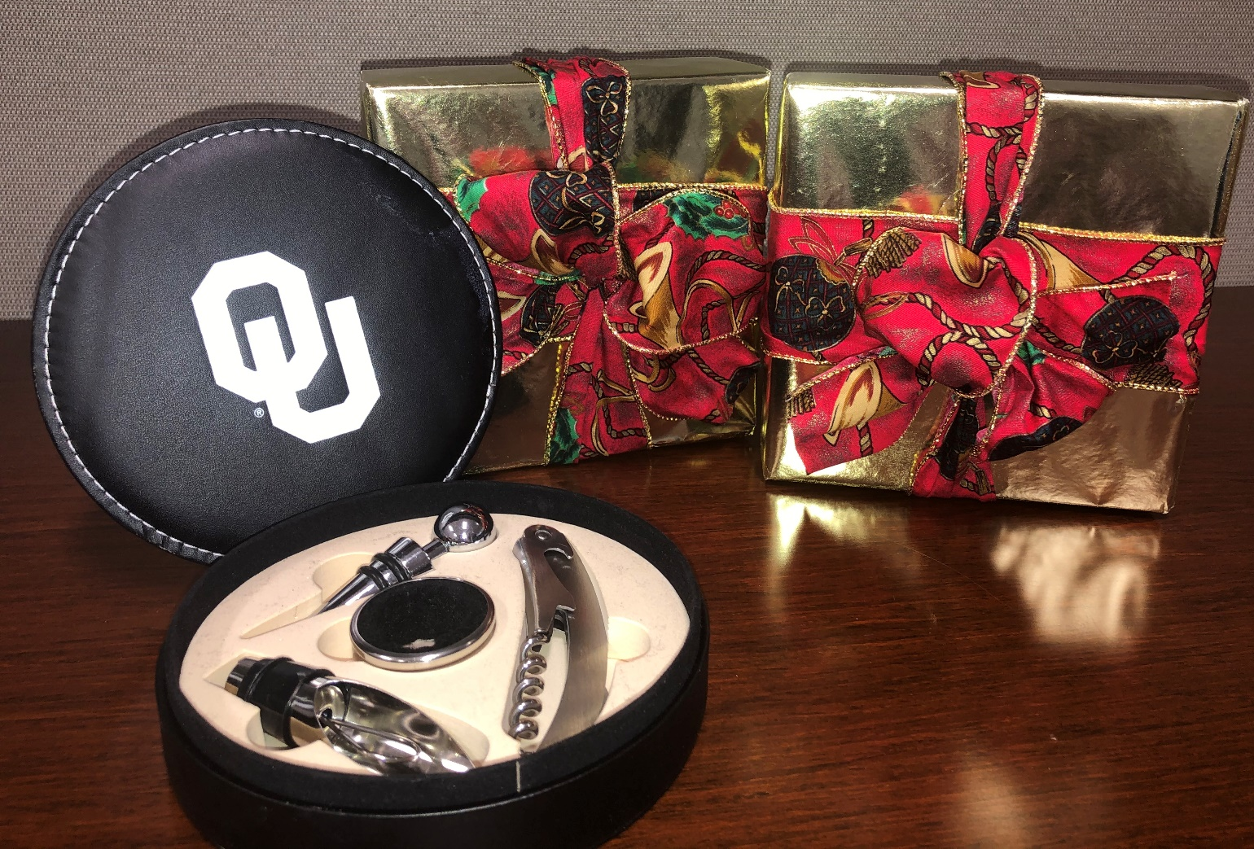
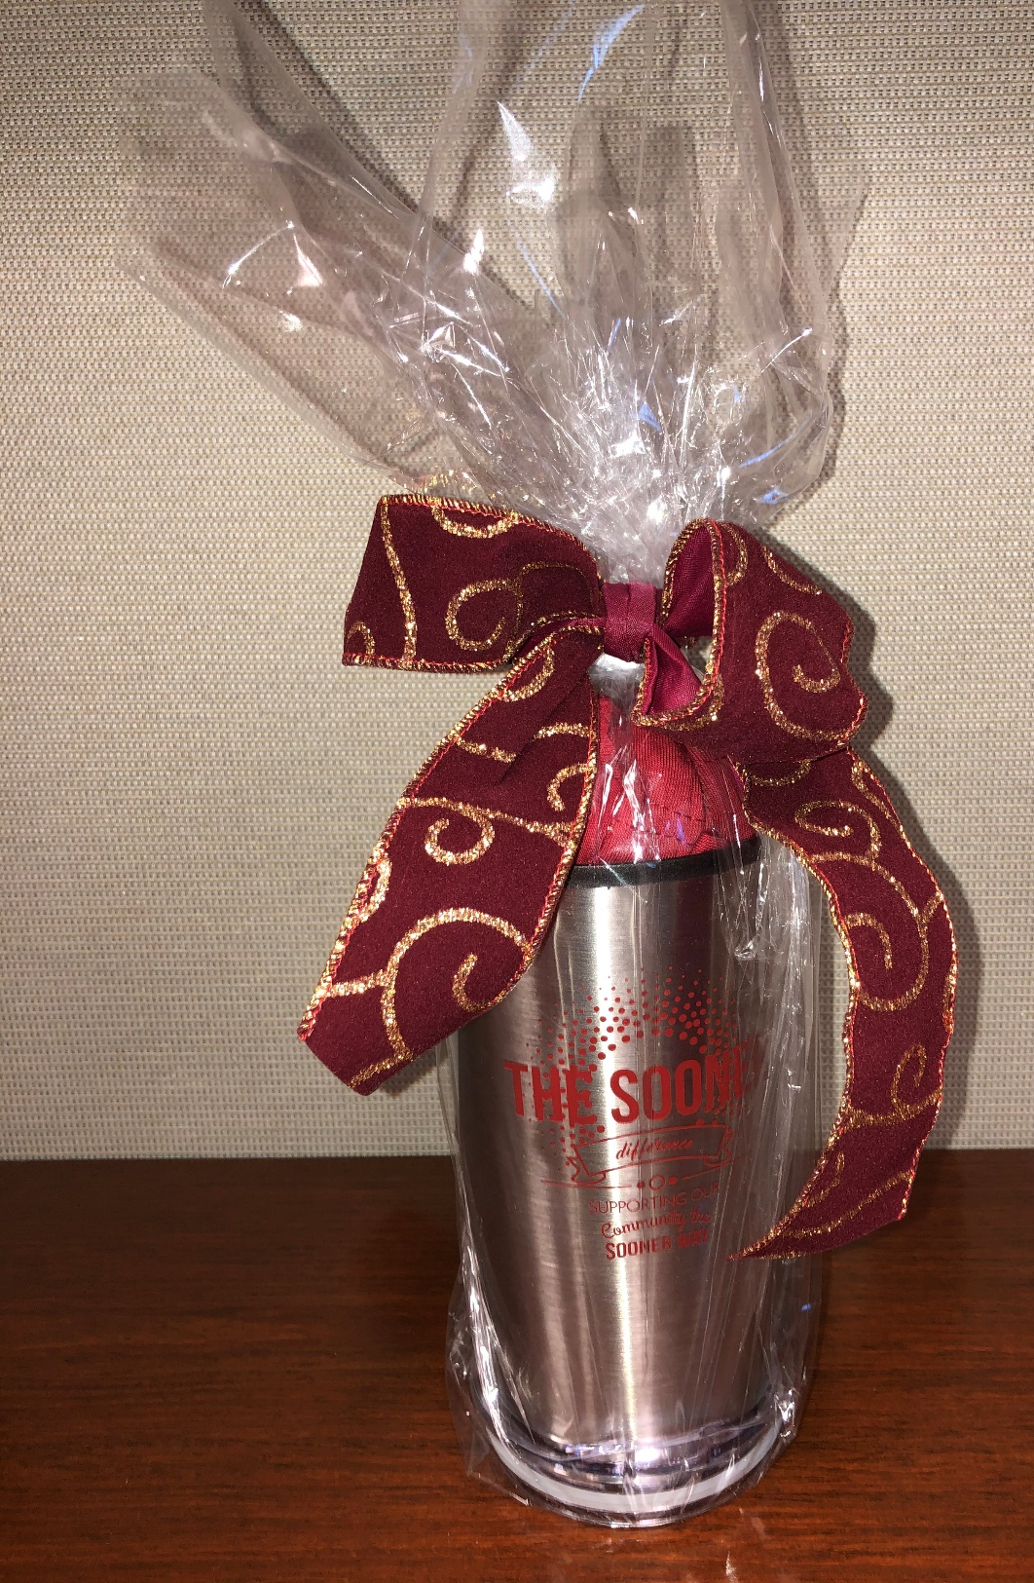
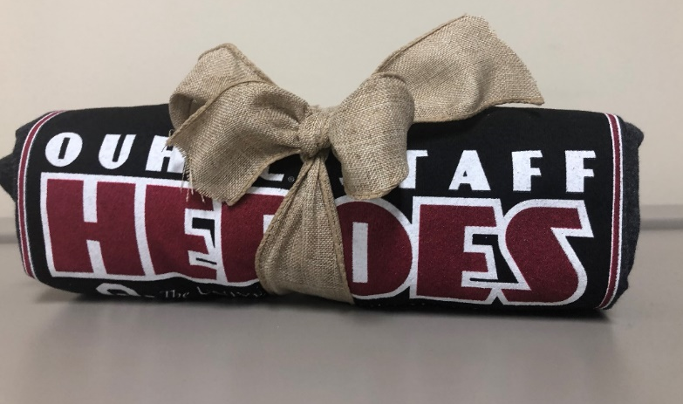
Sale Dates
Dec 2- Dec11th
12-2pm or by appointment
Staff-senate@ouhsc.edu
Gift Wrapped OU Leather Wine set $15
Gift Wrapped OUHSC Tumbler with Staff week
T-shirt
$20
CASH AND CARRY/ Supplies Limited
Staff Senate Office
Research Park
Building 865, Suite 529
Staff Week T-shirts $10

Slide 26
Office of Diversity, Equity, and Inclusion |Phone: (405) 325 7314

Slide 27
MOBILE MARKET/pantry box distribution
Mobile Market Dates/Locations
Thursday, 12/3 –Cancer Center Parking Garage
Thursday, 12/10 Parking Lot 10W (South of Library)
Thursday, 12/17 Parking Lot 10B (East of Harold Hamm)
Tuesday, 12/22 Location TBD
All sites open 11:30-1pm
Volunteers are needed
Please contact Kelli-walsh@ouhsc.edu to sign up for a December Date.

Slide 29
Looking Ahead to 2021
General Meetings will remain on Zoom
Future Speakers
Staff-senate@ouhsc.edu

Slide 30
OUHSC-Staff Senate
Staff Senate…
Find us!
@OUHSCS
@ouhscstaffsenate

Slide 31
Building CommUNITY
You Matter.
Get informed.
Get Involved.
Staff Senate
Next meeting-
Thursday, February 4, 2021 10am via Zoom

