Slide 1
Staff Senate Meeting April 1, 2021

Slide 2
I may not be a smart man Jenny, but I know where the mute button is…

Slide 3
FEATURED SPEAKER

Slide 4
OUHSC Staff Senate Business
Call to Order time
March minutes and Treasurer report will be approved via email and posted to the website. These can then be found on the Staff Senate webpage. www.ouhsc.edu/staff senate

Slide 5
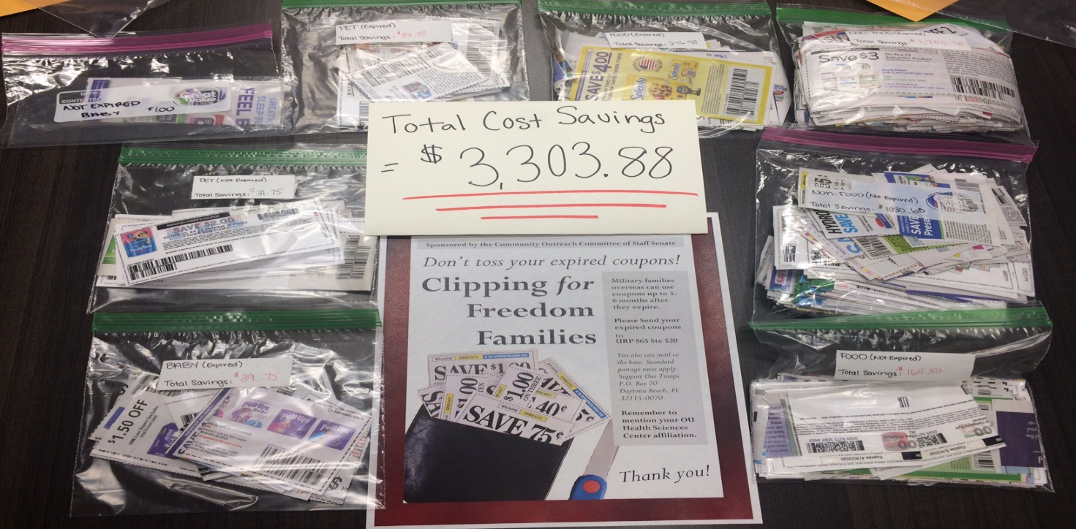
Community outreach committee
Thank you to everyone who donated coupons for our Troopons drive. We collected and mailed out thousands of coupons that will save the troops more than $3300!

Slide 6
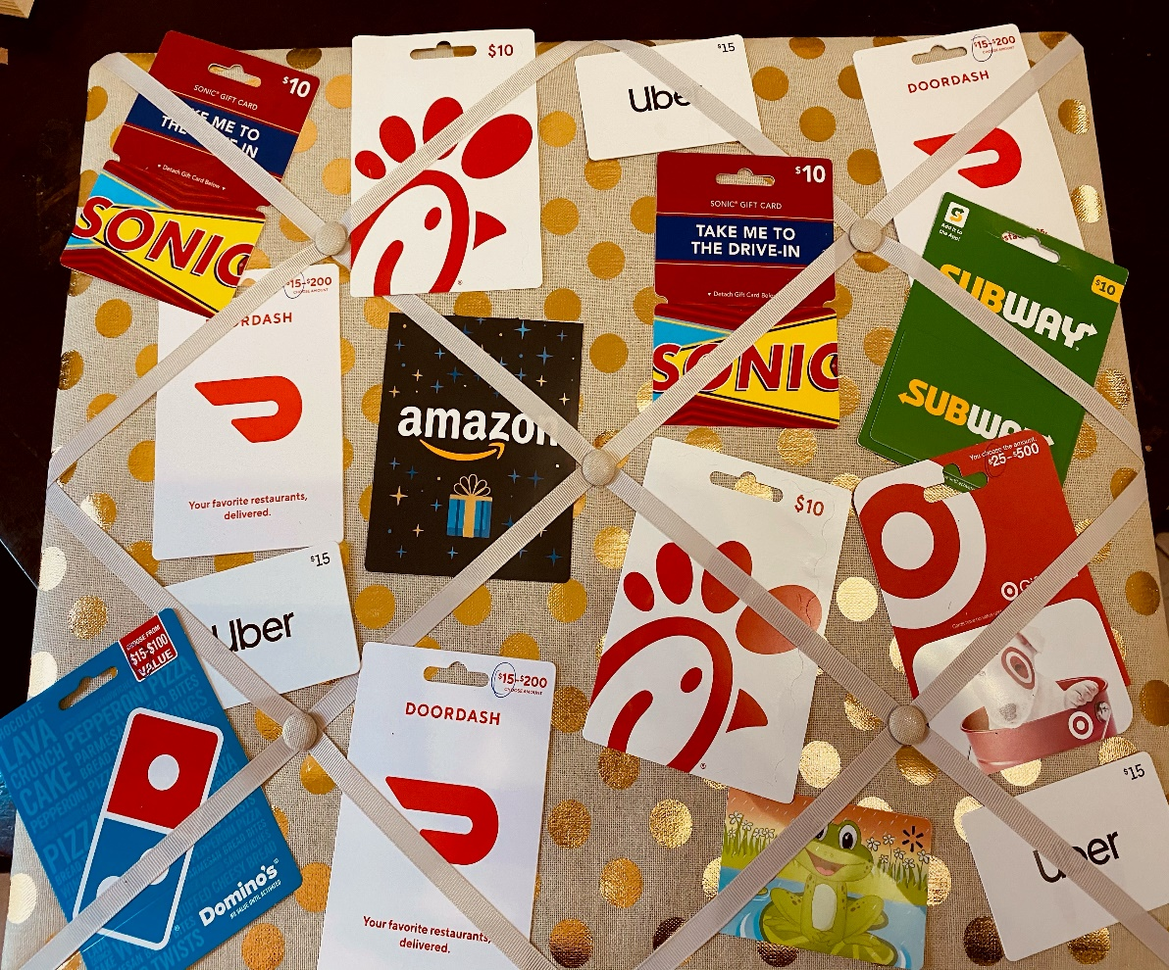
Community outreach committee
OK Kids Korral Donations. In lieu of our annual in person guest chef meal, our committee decided to donate their own money so we could purchase gift cards for families staying there. So far $190 in cash and $30 in gift cards have been donated. If you would like to donate to this project, please contact Kyndall-Wahkinney@ouhsc.edu

Slide 7
Staff Senate Spotlight

Slide 8
Committee on committees
At this time, all committees have full rosters.
Senator report
2 current Senator vacancy- College of Medicine
Carol Clure 271-2054 Carol-Clure@ouhsc.edu

Slide 11
Communication committee
HSC Staff Senate Communication invites staff with a background in graphic design, marketing, or communication to consider joining the team for the 2021-2022 year!
Facebook.com/OUHSCStaffSenate
Meetings will be held on the 3rd Thursday of each month.

Slide 12
Employee of the Month
April 2021
Thomas Wilson
Research Management Coordinator
Department of Pediatrics
College of Medicine

Slide 13
Employee of the month committee
Eligibility- FT, Non faculty appt. Worked at least 5 consecutive calendar years.
3 letters of support from OUHSC personnel (one from direct supervisor)
Nominee must not have received the Employee of the Month award in the past five years.
Complete eligibility and details can be found on our Staff Senate website.

Slide 14
fundraising committee
A huge THANK YOU for supporting our Spring Flower Fundraiser. $3538.00 RAISED!
We would love to see photos of your flowers in bloom this summer. Maybe with your pet?
We will be holding a Cutest Pet Photo Fundraiser in June. Be getting your pet “photo ready” and send in your cutest shot. More details to come.

Slide 15
Staff EVENTS Committee
Staff Events committee met on March 22nd via Zoom.
Currently working on planning for Staff Week Event scheduled for week of April 26th.

Slide 16
Employee recognition Committee
Our Annual Employee Recognition
Will be held this year on April 30th at 10:30 am as a virtual event.
Award Recipients should have received communication via email.

Slide 17
New business and announcements
THE FOLLOWING SLIDES ARE THE UPCOMING EVENTS FOR OUHSC
IF YOUR DEPARTMENT WOULD LIKE AN
EVENT FEATURED HERE PLEASE EMAIL Nancy-Geiger@ouhsc.edu

Slide 18
Staff Senate is currently seeking interested individuals for the following positions:
Executive Committee:
Treasurer
Secretary
Chair Elect
Communications Committee (for Graphic Design work)
Interested? Please contact Carol-Clure@ouhsc.edu or
Nancy-geiger@ouhsc.edu or staff-senate@ouhsc.edu
for job descriptions or additional information.

Slide 19
Important Information About Your 2020 Health Care and Dependent Daycare FSA
The COVID Relief Bill, allows employers to modify their benefit plans to help provide relief and greater flexibility to participants who have a Health Care and/or Dependent Daycare Flexible Spending Accounts.
Here are the details of the temporary plan to amend our benefit plan.
You now have more time to use- FSA funds for year 2020 have been extended and you can use the 2020 balance through December 31, 2021.
If you had a health care FSA that you ceased to participate in during 2020, you will be allowed to receive reimbursements from unused contributions through the end of the plan year in which you ceased your participation (including any grace period).
You will be allowed to claim expenses for a child on your dependent care FSA who turned 13 during the 2020 plan year (the election period ending on or before January 31, 2020 and any extension to that plan year).
Have questions- contact HR at ohr@ou.edu

Slide 25
The Hudson College of Public Health Student Association is celebrating National Public Health Week April 5-9. Everyone has interacted with a public health worker over the last year in one way or another, and now, more than ever, they need to be shown some LOVE!
We would love to have an outpouring of support by having thousands of people sign our virtual card, which will be emailed to our faculty, staff, students and alumni on April 7th.
Follow the below link to sign the card celebrating all that public health officials in our community do!
Leave your message of thanks by April 6th!
Sign the Virtual Card: http://bit.ly/OUpublichealth

Slide 26
Staff Senate…Find us!
OUHSC-Staff Senate
@ouhscstaffsenate
@OUHSCS

Slide 27
Next Staff Senate Meeting
Thursday, May 6th 10am via zoom

